Slide 1
Commands:
ls,
cd,
mkdir,
rmdir,
echo,
nano,
cat,
hostid,
date,
sudo,
whoami,
ps,
pwd,
whereis aprops,
top,
du -sh,
ls -R,
ls -a,
cd ..,
mv,
ls -ltr,
Chmod 777 filename,
history,
cal ,
du-h
du -ah,

Slide 2
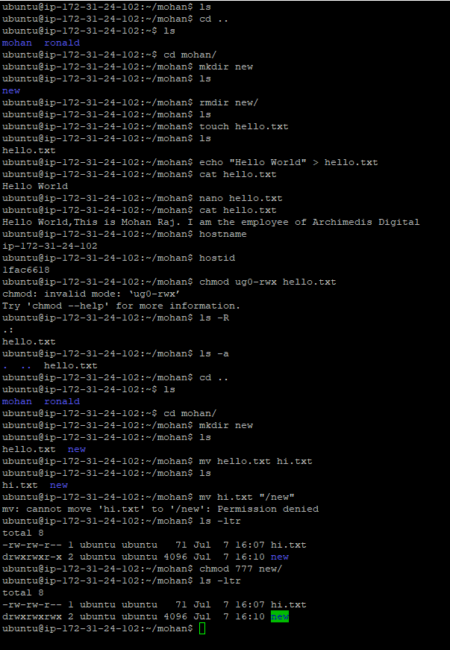
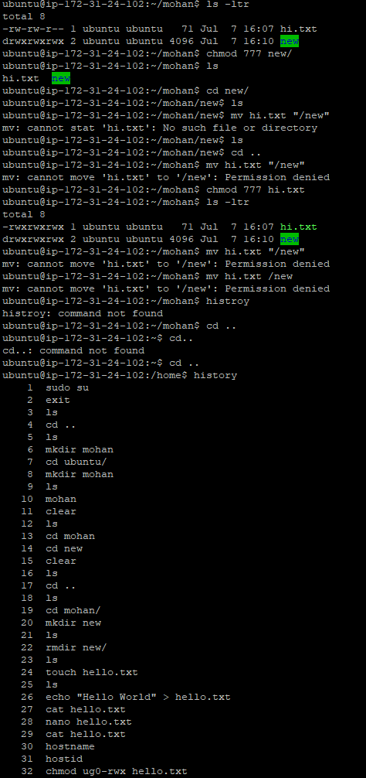

Slide 3
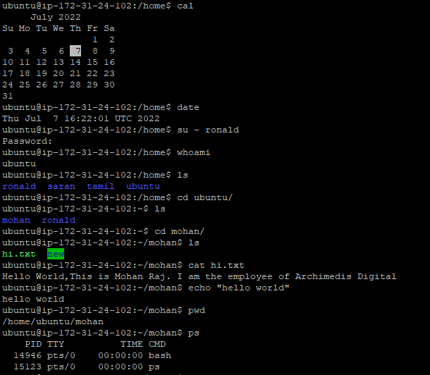
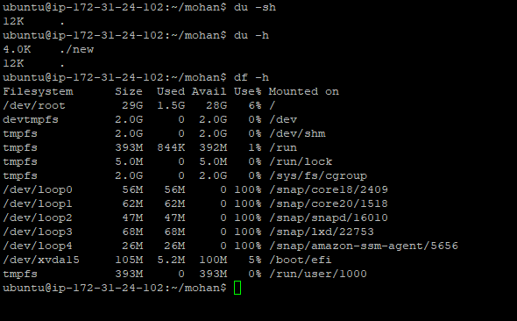

Slide 4
